Slide 1

Post-Ups
COMP 8157: Advanced Database Topics
Prepared By: Group 21
Aayushee Dave(110023928)
Manan Parmar (110022360)
Rahul Pandya(110024678)
Richa Gupta(110013520)
University of Windsor
Date: 11th Aug, 2020

Slide 2

Outline
What is Post-Ups?
Technology Stack
Why NoSQL Database – MongoDB
Demonstration
What’s happening Underneath?
Similar Applications
References & Documentations

Slide 3
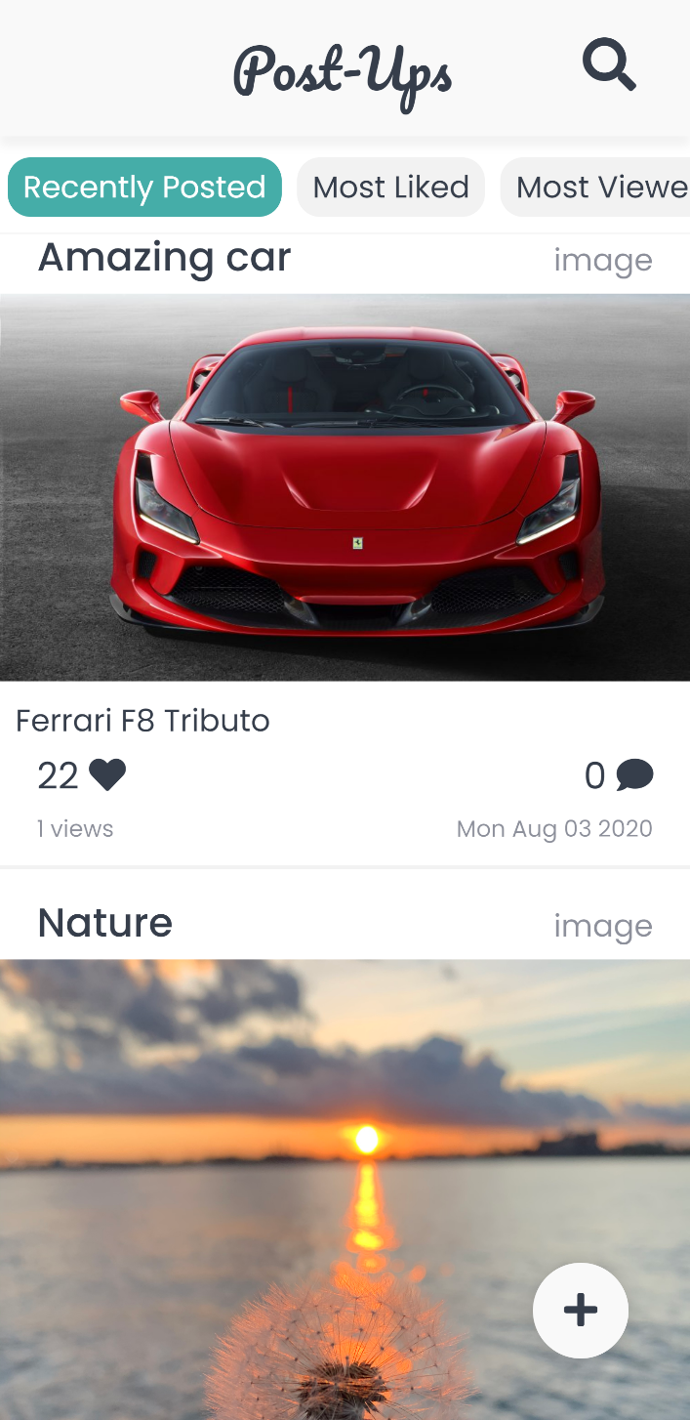
What is Post-ups?
Post-Ups – It's what's trending
Share your ideas to the world
AKA, “Social Website”
Features:
Share Post- Image, Text, Audio or Video
Like, Comment and Sort & Filter Posts
Double Tap to Like

Slide 4

Technology Stack
Database: MongoDB using Mongoose Framework
Backend: Express.js with Node.js
Frontend: Angular 9 Framework
File Manipulation: GridFS and Multer Library
Deployment: Heroku Platform

Slide 5

Why NoSQL Database – MongoDB
Schema-Less Database
Document-Oriented
JSON like - Rich Queries
Indexing
Sharding
Aggregation
Easier to implement and interact
Scalability & Replication - High Availability

Slide 6

Demo
Please scan the QR code to have a hands-on with our application
Or visit the link mentioned in the slide to participate
https://post-ups.herokuapp.com/

Slide 7
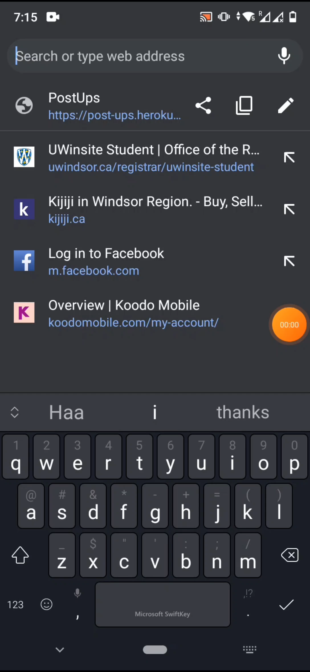
Demo
Glimpse of features in Post-Ups
Scroll through Feed
Has Text, Audio, Video as well as Image Posts ( Gifs Included 😉 )
Click ‘ + ’ button to Add New Post
Comment on posts
Don’t forget to double tap the Post ‘❤️’
Filter through posts
Click on tags to see related posts
Try the available sorts
Explore the Posts – listen to audios, view images, play videos and read text
https://post-ups.herokuapp.com/

Slide 8
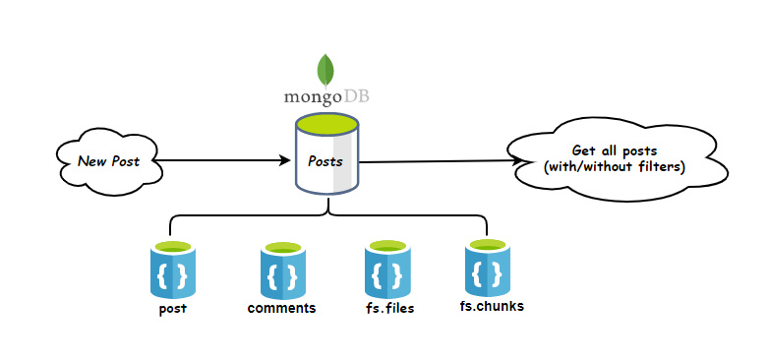
What’s happening Underneath?
Block Diagram
https://post-ups.herokuapp.com/

Slide 9
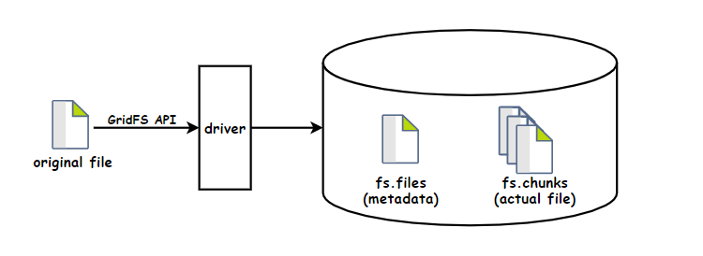
What’s happening Underneath?
Sharding Using GridFS
https://post-ups.herokuapp.com/

Slide 10
What’s happening Underneath?
How feed is fetched?
Post = {
"_id": "5f28fb22d7ce4e41ecff89c9",
"tags": [“car“, “red”],
"category": “image",
"likes": 141, "views": 109, "comments": [{…}, {…}],
"title": “Red Ferrari",
"textContent": “Check out my Red Horse",
"datePosted": "2020-08-04T06:07:30.365Z",
"metadata": "5f28dd9478ba603d28e0695c",
"file": {
"_id": "5f28dd9478ba603d28e0695c",
"length": 2803198,
"filename": "5f28fb22d7ce4e41ecff89c9.jpeg",
"contentType": "image/jpeg",
"metadata": { "postId": "5f28fb22d7ce4e41ecff89c9" }
}
"data": [ {…}, {…}, {…},
{
"_id": "5f28dd9478ba603d28e0695e",
"files_id": "5f28dd9478ba603d28e0695c",
"n": 3,
"data": "BnAslKdjsnw@/sdklozfytnwi.....(255 kB)"
}, {…}, {…}, {…}
]
}
Post.aggregate([
{ $match: { tags: { $in: [“car”,”red”] } } },
{ $match: { category: ”images” } },
{ $sort: {"datePosted": -1} },
{ $limit: page.limit + page.skip },
{ $skip: page.skip },
{
$lookup: {
from: “fs.files",
localField: “metaData",
foreignField: "_id",
as: "file",
},
},
{
$lookup: {
from: “fs.chunks",
localField: "file._id",
foreignField: "files_id",
as: "data",
},
},
]);
https://post-ups.herokuapp.com/

Slide 11

Similar Applications
Instagram
PostgreSQL
Cassandra
Facebook
MySQL
Cassandra
Twitter
MySQL
FlockDB
All these Applications use NoSQL in addition to SQL Database
Takeaways:
using SQL in Combination with NoSQL for better performance
Partitioning is best feature of MongoDB as it is a CP data store (refer CAP theorem)
https://post-ups.herokuapp.com/

Slide 12
References
Documentations
Using MongoDB for social networking sites: https://www.researchgate.net/publication/274012240_Using_MongoDB_for_Social_Networking_Website
NoSQL Databases as Social Networking Storage Systems: https://papers.ssrn.com/sol3/papers.cfm?abstract_id=3282559
MongoDB Documentation: https://docs.mongodb.com/
Angular Documentation: https://angular.io/docs
Mongoose Documentation: https://mongoosejs.com/docs/
Express Documentation: https://expressjs.com/en/api.html
Fireship Documentation: https://fireship.io/
GridFS – Multer Integration: https://www.npmjs.com/package/multer-gridfs-storage

Slide 13
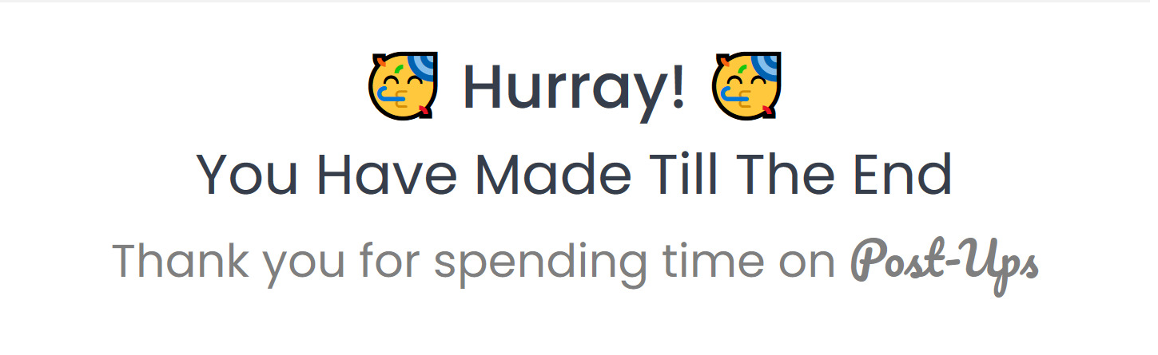
Thank You!!!

Slide 14

Any Questions?

